Slide 1

Introduction to Machine Learning 2
Classification

Slide 2
Copyright Notice
The material within this presentation, excluding externally sourced images and animations, is fully owned by the Curtin Machine Learning Club. No redistributing, modification, nor commercialisation is allowed without written consent from the copyright holder.
Copyright © 2022 Curtin Machine Learning Club

Slide 3
Acknowledgement of Country
Curtin University would like to pay our respect to the Aboriginal and Torres Strait Islander members of our community by acknowledging the traditional owners of the land on which the Bentley Campus is located, the Wadjuk people of the Nyungar Nation; and on our Kalgoorlie Campus, the Wongutha people of the North-Eastern Goldfields, past, present, and emerging.

Slide 4


Hardware Required

Slide 5
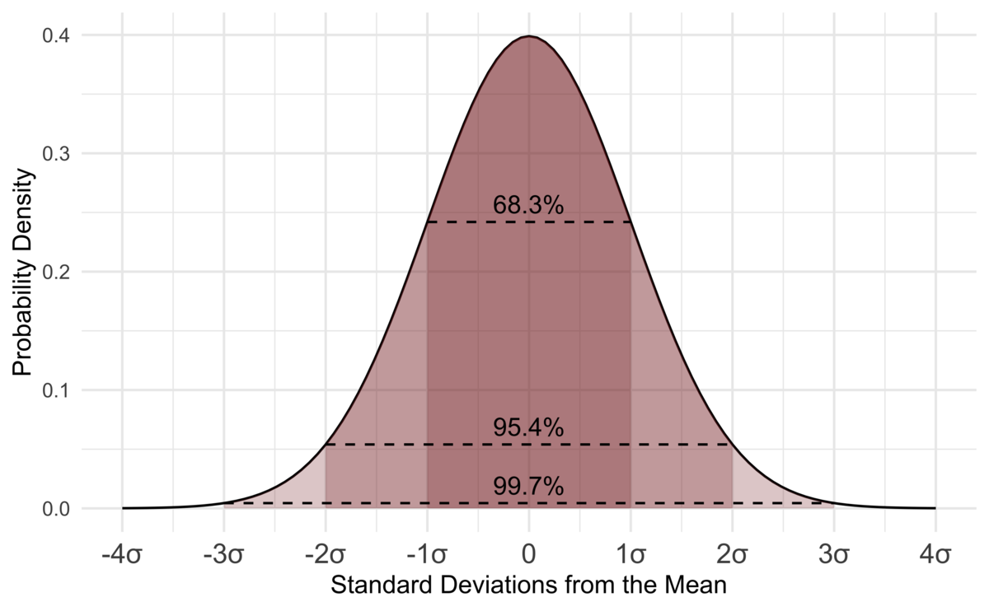

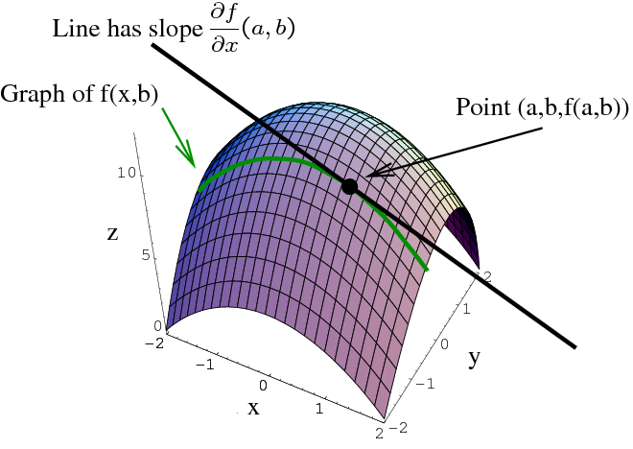
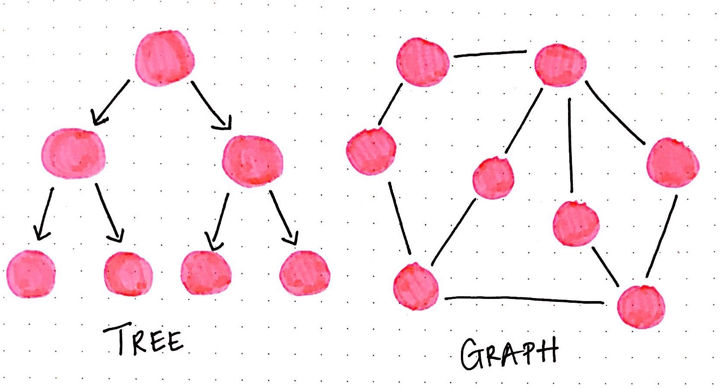
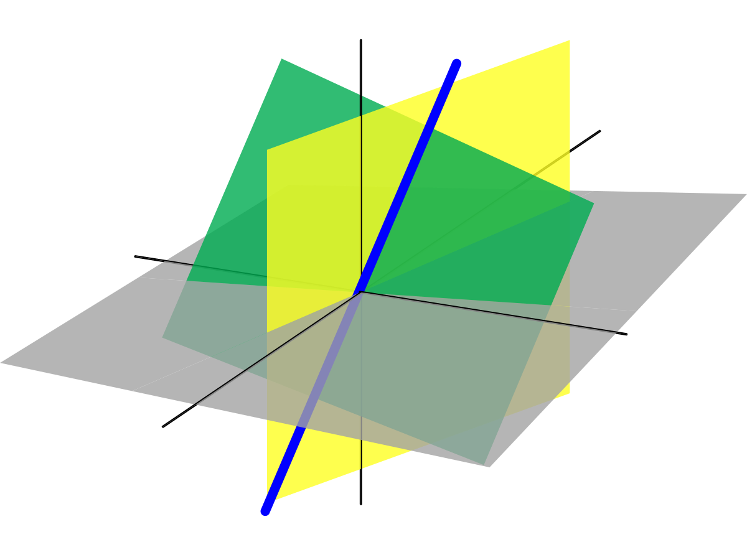
Machine Learning Mathematics

Slide 6
So What Happened Last Week?

Slide 7
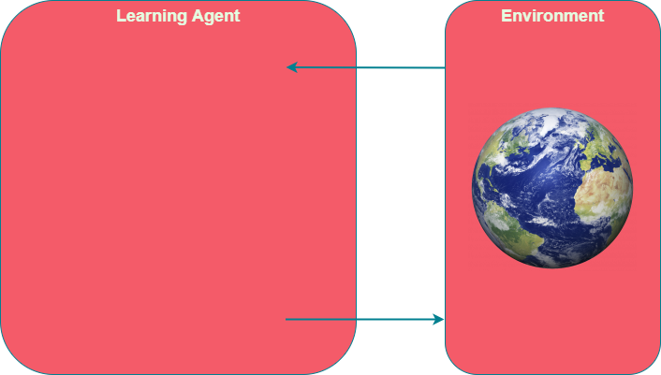
So What Was ML Again?

Slide 8
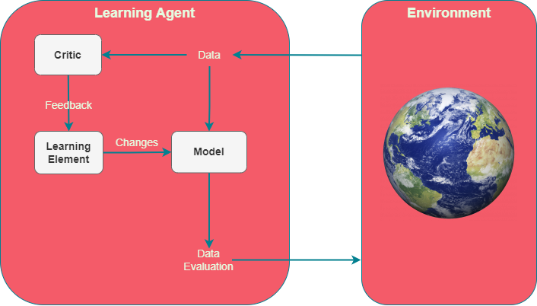
ML at its Core
Critic evaluates performance
Learning element learns from feedback
Model Analyses data

Slide 9
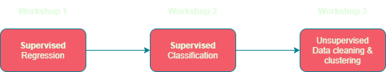
Workshop Timeline

Slide 10
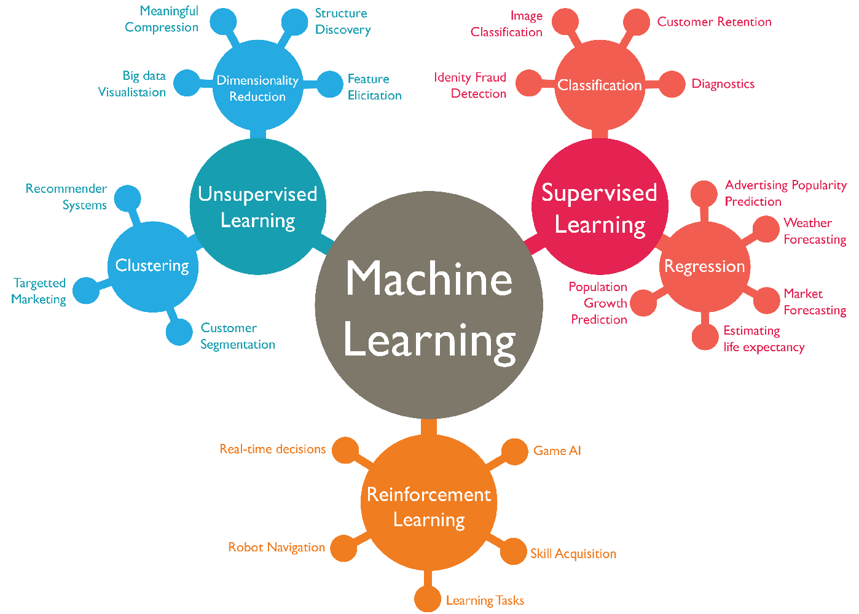
Main Types of ML
Supervised
Train a predictor
Unsupervised
Organise unstructured data
Reinforcement
Real time feedback

Slide 11
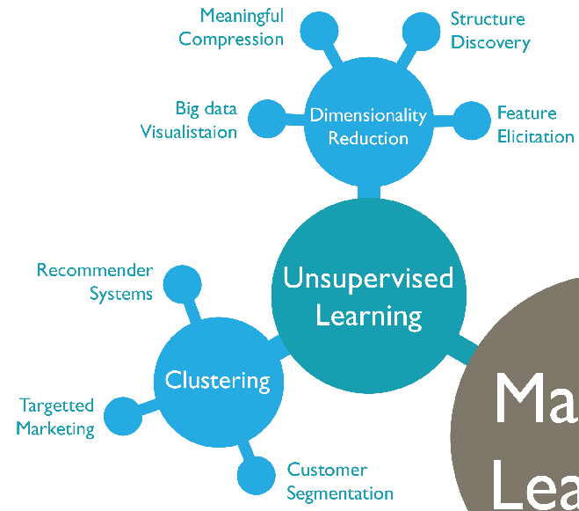
Unsupervised Learning
Finding patterns in data
Reducing dimensions
Novelty Detection

Slide 12
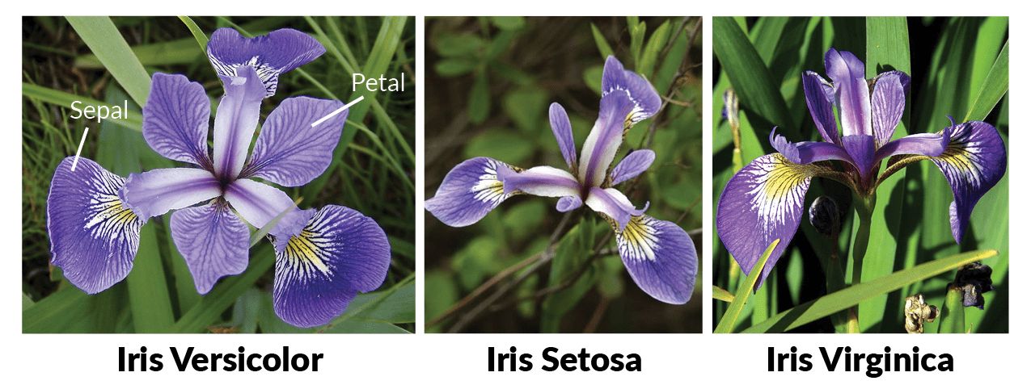
Iris dataset

Slide 13
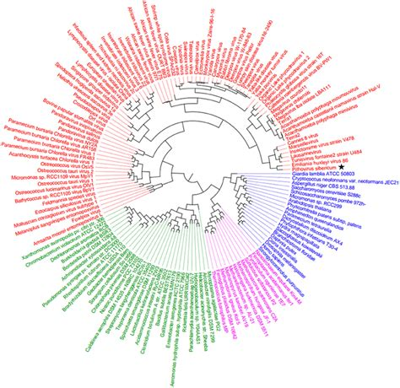
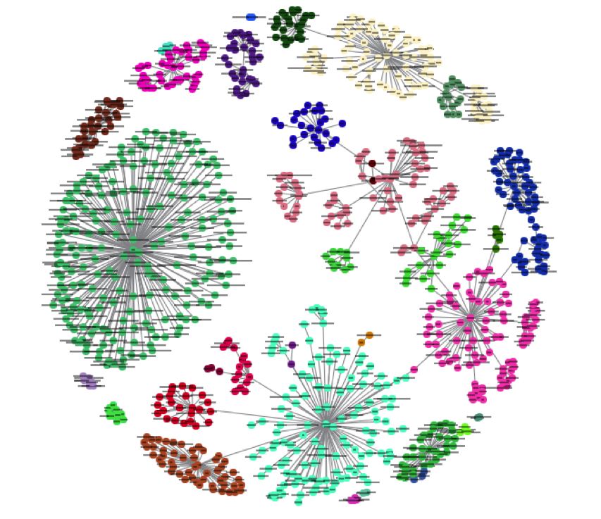
Clustering
Sometimes, you just have a mess!

Slide 14
Hierarchical Clustering

Slide 15
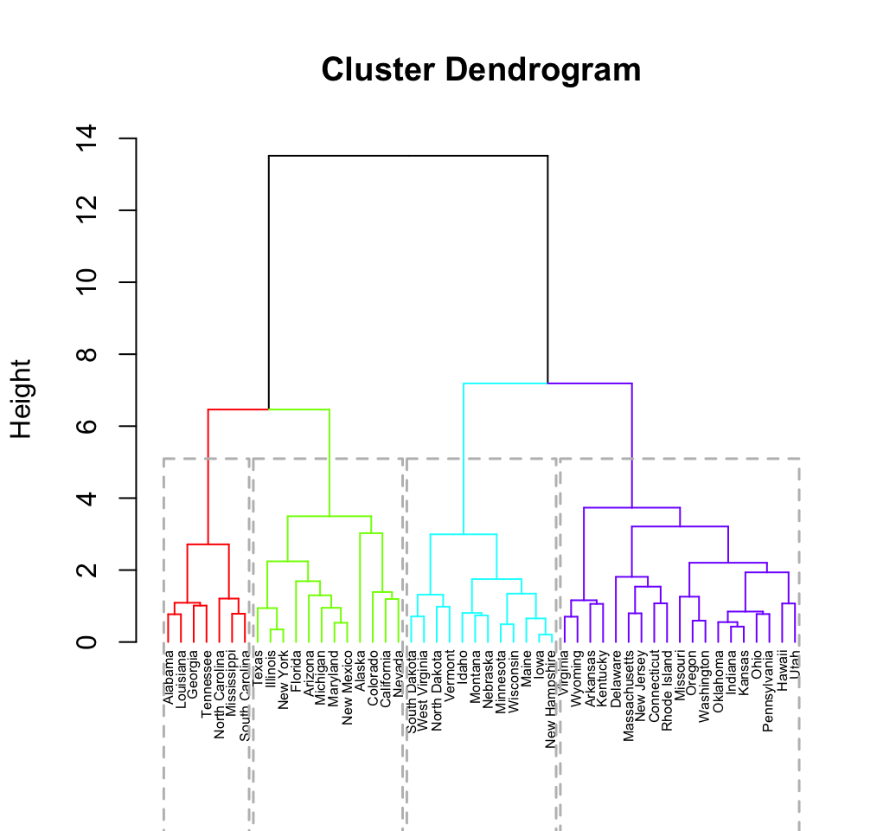
Hierarchical Clustering
Combine/split clusters
Repeat until done
Very slow!!

Slide 16
K-means

Slide 17
Enough talk, let’s do it!

Slide 18
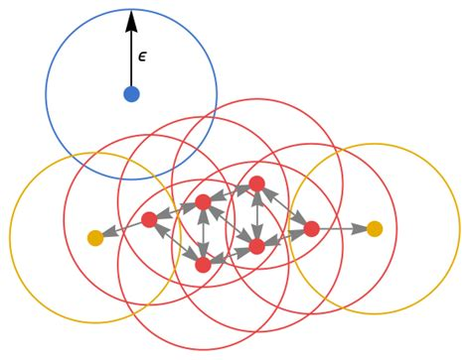
DBSCAN
Find core points
Core if within ε distance of min number of points
Connect core points with each other
Connect other points within ε of a core point
Detect outliers

Slide 19
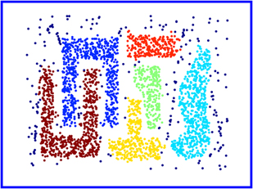
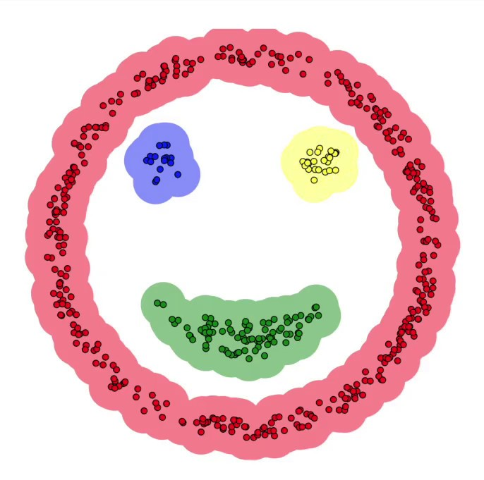
DBSCAN - Pros

Slide 20
Let’s try DBSCAN!

Slide 21
What are features?
Model
Is it a scam email?

Slide 22
How about these?
Location
w1
Model
domain
w2
Is it a scam email?
Typos
w3
Requests details
w4
w5
Urgency

Slide 23
Combatting Overfitting
Split labelled data into training and testing sets
At least 50% for training
Train on training data
Test accuracy on the testing data

Slide 24
Confusion Matrix
Actual Value
 | Positive | Negative
Positive | TP | FP
Negative | FN | TN
Predicted Value

Slide 25

Finding our Neighbours

Slide 26
Let’s try KNN!

Slide 27
Consider the Following
Need model to predict disease in patients.
99% of patients do not have the disease.
How can we maximise accuracy?

Slide 28
My Solution
Always assume patient does not have the disease
99% accurate!

Slide 29
Precision vs Recall

Slide 30
Logistic Regression

Slide 31
Logistic Regression Maths

Slide 32
Let’s try Logistic Regression!

Slide 33
Support Vector Machines

Slide 34
SVM with Non-Linear Data

Slide 35
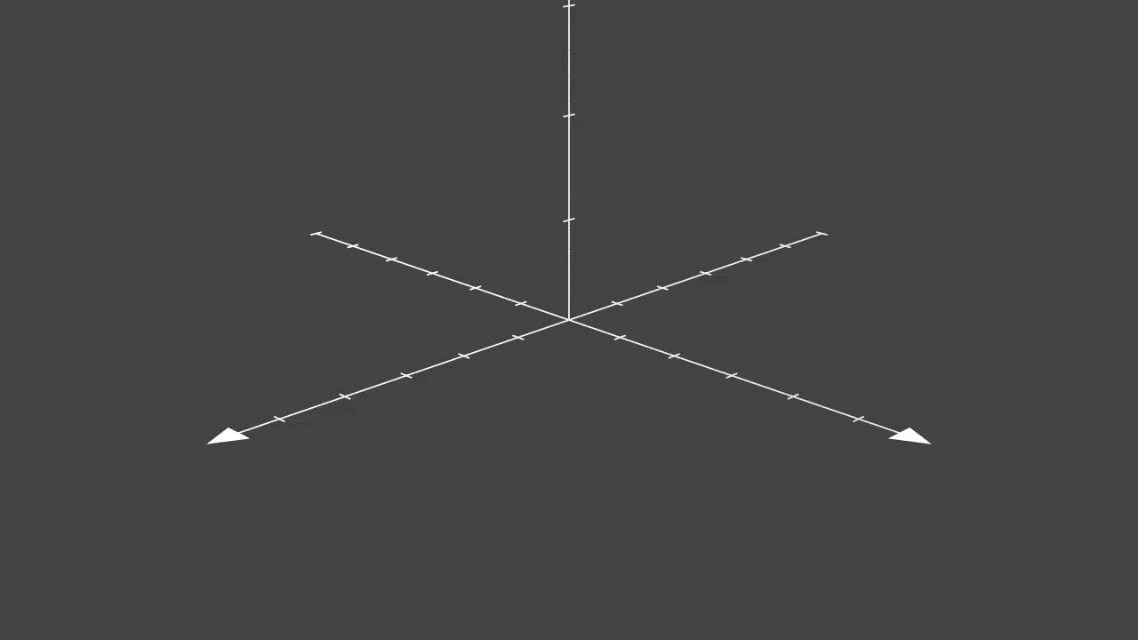
Kernel Trick

Slide 36
Let’s Try SVM!

Slide 37
Dealing with Complex Data
Problems
What if we have hundreds of features?
What about thousands?
Answers
Reduce number of features.
Fine tune hyperparameters.

Slide 38
Hyperparameter Tuning
Very tedious and time consuming.
What happens when search space is high?
SVM: C value, choice of kernel, kernel hyperparameters, etc.

Slide 39
Meta-learning
BIC values for polynomial regression
Grid search in the general case
Create grid of hyperparameter values to test
Find best model

Slide 40
Let’s model some complex data

Slide 41
What’s Next?
Tutorials
Projects
Google ML course
3Blue1Brown videos
Exploring NNs – Sem 2!
Handwriting detection
Face detection
Audio processing
Voice recognition

Slide 42
Bibliography
Jupyter Notebook: https://jupyter.org/
Google ML glossary: https://developers.google.com/machine-learning/glossary/#m
IBM Machine Learning: https://www.ibm.com/cloud/learn/machine-learning#toc-real-world-Lyja9GSr
GeeksforGeeks Machine Learning: https://www.geeksforgeeks.org/machine-learning/

